Slide 1
Gokul S 715521104012 PSG iTech
Final Project
03/04/2024 Annual Review

Slide 2
Deep Neural Network for Recognizing Handwritten Digits
Develop a deep learning model capable of identifying handwritten digit images sourced from the MNIST dataset.
03/04/2024 Annual Review

Slide 3


AGENDA
Problem Statement
Project Overview
End Users
Solution and Value Proposition
Unique Aspects of the Solution
Modelling
Results
03/04/2024 Annual Review

Slide 4

PROBLEM STATEMENT
The objective of this project is to create a model that accurately identifies digits from a dataset containing tens of thousands of handwritten images sourced from the MNIST dataset. MNIST comprises approximately 10,000 images depicting handwritten digits ranging from 0 to 9.
03/04/2024 Annual Review

Slide 5

PROJECT OVERVIEW
Gathering data, architecting the model, conducting training, assessing performance, and implementing deployment are among the key processes in this project. Deep learning frameworks such as TensorFlow and Keras are utilized for building and training the network. The project emphasizes optimization and iterative experimentation to achieve optimal results.
03/04/2024 Annual Review

Slide 6

WHO ARE THE END USERS?
Researchers and practitioners investigating deep learning, image generation, or handwriting recognition.
Instructors specializing in teaching deep learning or image generation techniques can leverage this tool.
Developers or engineers engaged in projects involving handwritten digit applications, such as optical character recognition (OCR).
03/04/2024 Annual Review

Slide 7

SOLUTION AND ITS VALUE PROPOSITION
Utilizing TensorFlow/Keras, design an architecture featuring a discriminator network and a generator.
Craft a neural network comprising multiple layers of activation functions (e.g., ReLU and Tanh) and fully connected (Dense) layers.
Adjust layer sizes, network depth, and normalization techniques.
Develop a neural network with a binary classification output that shares architectural decisions with the generator.
03/04/2024 Annual Review

Slide 8

THE WOW IN SOLUTION
Performance Optimization: Engaging in comprehensive experimentation and hyperparameter tuning to optimize the model's performance, leading to enhanced image quality and stability.
Innovative Network Architectures: Experimenting with diverse architectural designs for both the generator and discriminator networks to enhance the recognition of realistic and diverse digit images.
03/04/2024 Annual Review
8

Slide 9
MODELLING
Generator Network Architecture Exploration: Experiment with diverse architectures for the generator network, varying layer sizes, depths, and activation functions such as ReLU and Tanh to generate lifelike digit images.
Discriminator Network Architecture Development: Construct the discriminator network architecture, exploring different layer configurations and activation functions such as Sigmoid and Leaky ReLU to distinguish real from generated images effectively.
Hyperparameter Optimization: Perform extensive experimentation and hyperparameter tuning to fine-tune the GAN model's performance, focusing on parameters like learning rate, batch size, and network depth to achieve optimal results.
Training Process: Train the GAN model on the MNIST dataset, continually updating the generator and discriminator networks to improve image generation quality and stability over multiple iterations.
Performance Evaluation: Assess the trained GAN model's performance by examining generated digit images and evaluating their realism and diversity to ensure the model meets desired criteria.
03/04/2024 Annual Review
9

Slide 10
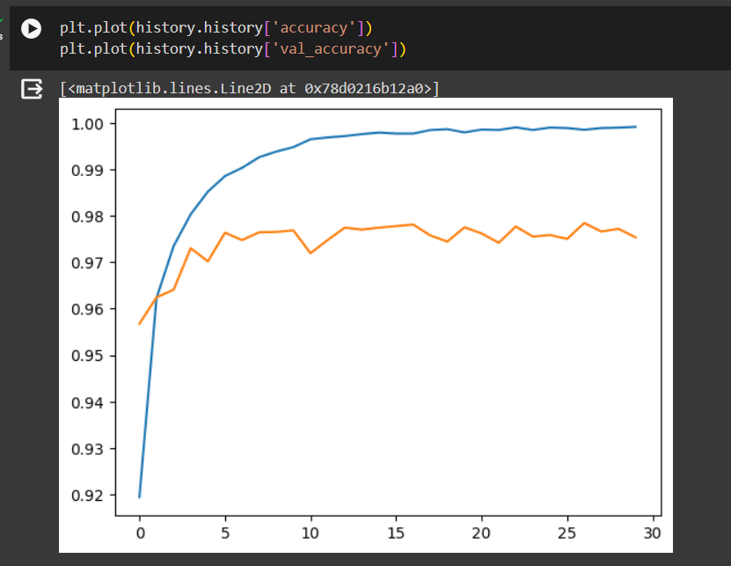
RESULTS
03/04/2024 Annual Review
10

Slide 11
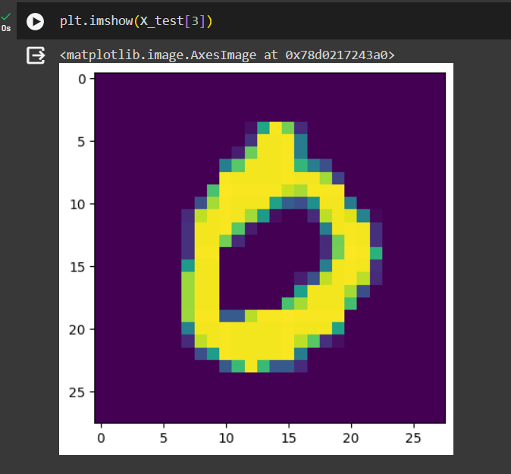
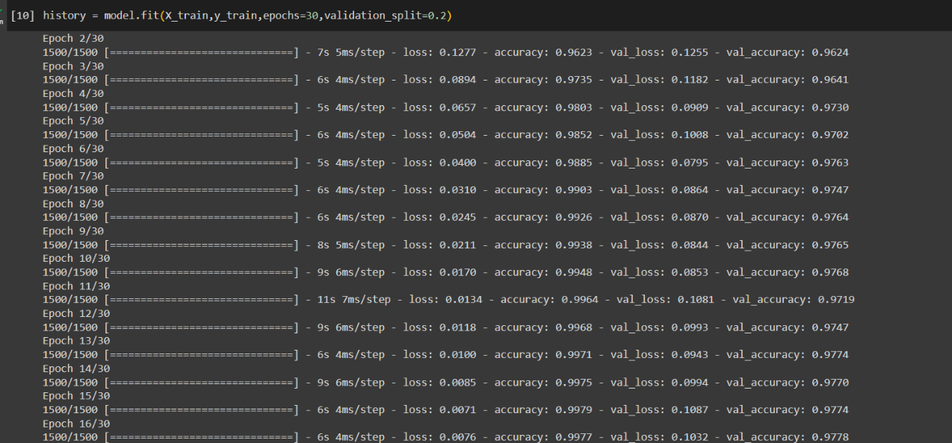
RESULTS
03/04/2024 Annual Review
11

Slide 12
CONCLUSION
In conclusion, our Deep Learning Network has demonstrated significant advancements in recognizing realistic handwritten digit images resembling those in the MNIST dataset. The comprehensive documentation facilitates straightforward deployment and accessibility, paving the way for broader applications in image recognition and beyond.
03/04/2024 Annual Review
12

Slide 13
REFERENCES
https://www.tensorflow.org/
https://keras.io/
https://numpy.org/
https://matplotlib.org/
scikit-learn: machine learning in Python — scikit-learn 1.4.1 documentation
MNIST handwritten digit database
03/04/2024 Annual Review
13

